Slide 1


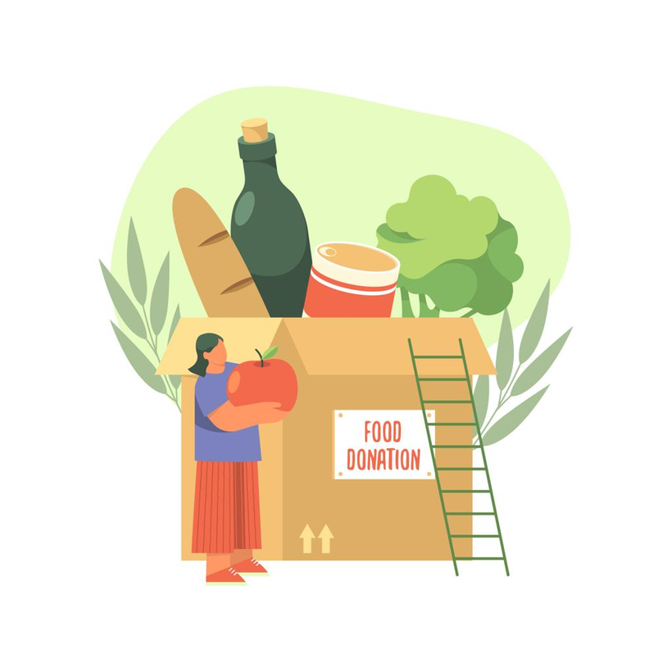
Team Name: SHAREVOLUTION-UTDI
Project Name: NUTRI-SHARE
Digital Innovation for Social Impact
SDG 2 – Zero Hunger | SDG 3 – Good Health & Well-being | SDG 12 – Responsible Consumption & Production

Slide 2


Team Members
Nurul Layli
Team Leader – System Analyst & PM
Arrafi Nur Hafiz
System Architect & Cloud Engineer
Acknowledgement: Universitas Teknologi Digital Indonesia (UTDI), Yogyakarta

Slide 3
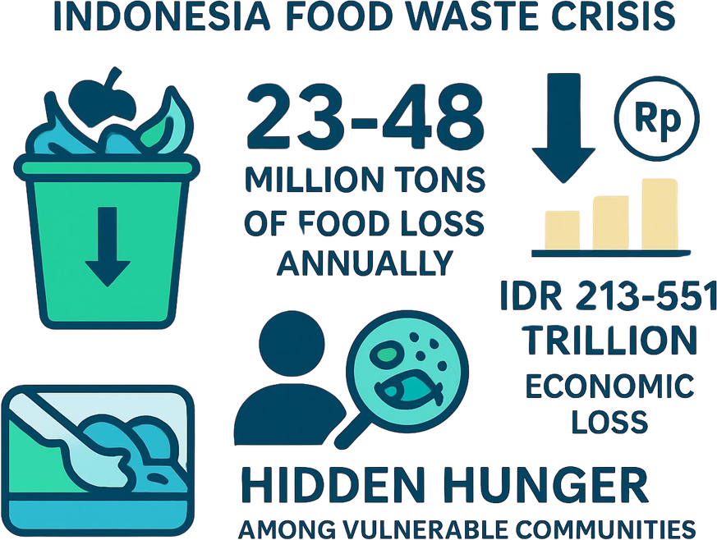
Problem Statement:
Indonesia faces a serious paradox: amidst the abundance of wasted food, many people still suffer from malnutrition, meaning that despite the abundant surplus, hidden hunger still exists.
Indonesia produces 23-48 million tons Food Loss & Waste per year, causing economic losses Rp213-551 trillion (BAPPENAS, 2021) is contrary to SDG 2 & SDG 12.
The HoReKa sector in Yogyakarta Special Region (DIY) is one of the largest contributors to food surpluses, while orphanages/social institutions are still experiencing "hidden hunger" (chronic malnutrition).
Existing redistribution platforms (Surplus Indonesian, Food Cycle, Garda Pangan) still use the system first-come-first-served, so that distribution is often not on target.
Root of the problem: There is no platform that integrates the Nutritional Adequacy Intake (AKG Permenkes No. 28/2019) into distribution decision-making.

Slide 4
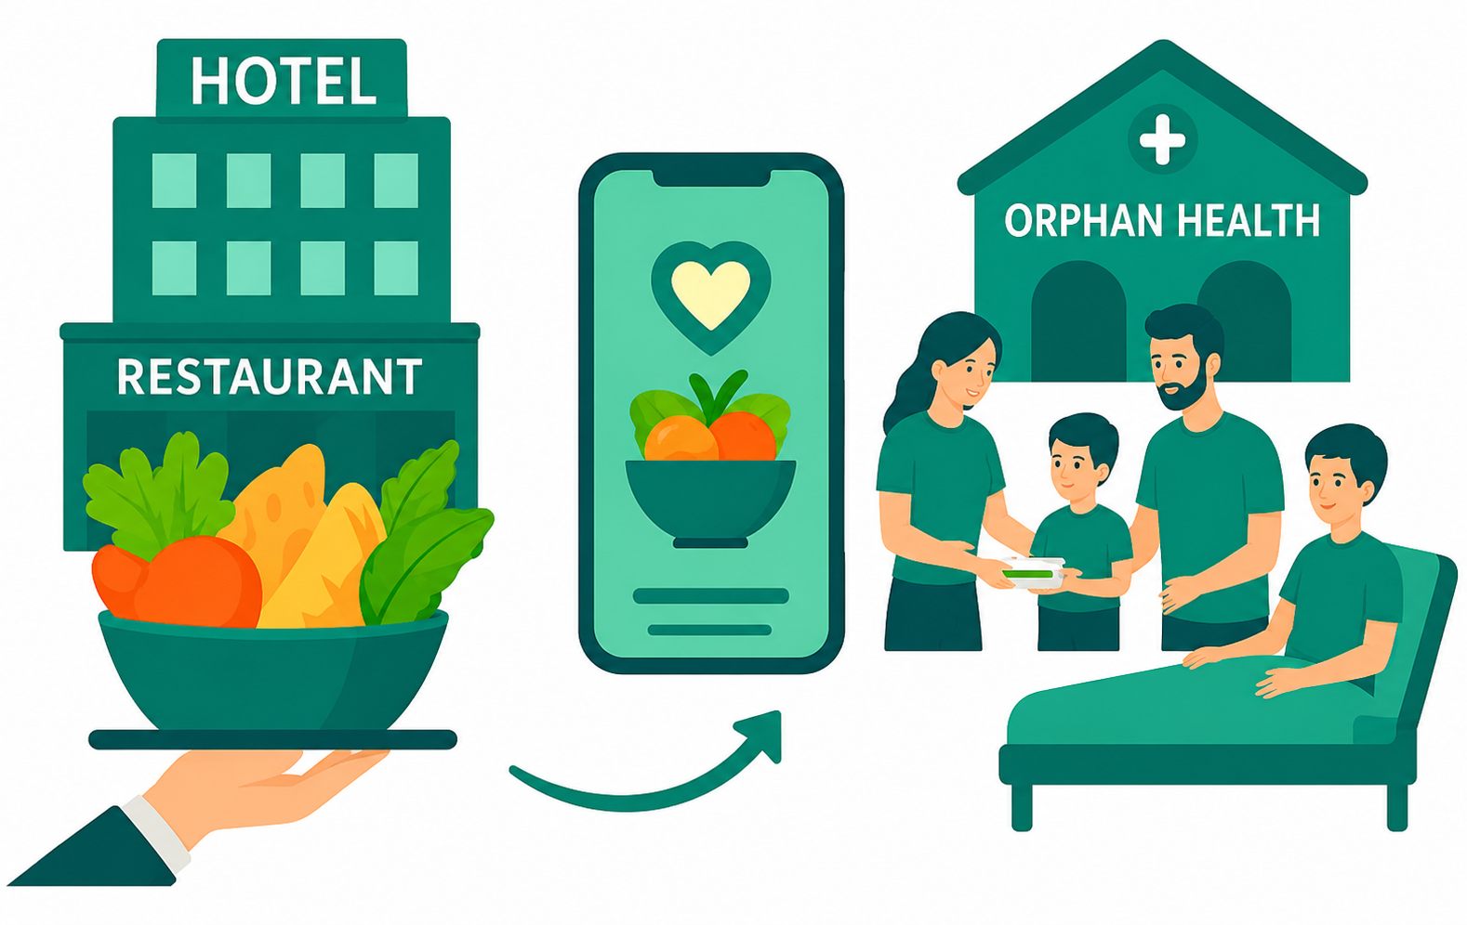
Introduction:
One of the most pressing global paradoxes: food is wasted while 820 million people remain undernourished (Chaudhary et al., 2026).
In Indonesia, this is compounded by "hidden hunger" micronutrient deficiency affecting children in orphanages and patients in shelters (Weffort & Lamounier, 2024).
Digital platforms (CIRCLE, Food Bridge, Zero Waste Chain) connect donors with recipients in real-time, reducing error and accelerating coordination (Ranjbari et al., 2024; Amrutkar et al., 2024).
Gap: no platform uses nutrition-based multi-criteria prioritisation this is what NUTRI-SHARE closes.

Slide 5
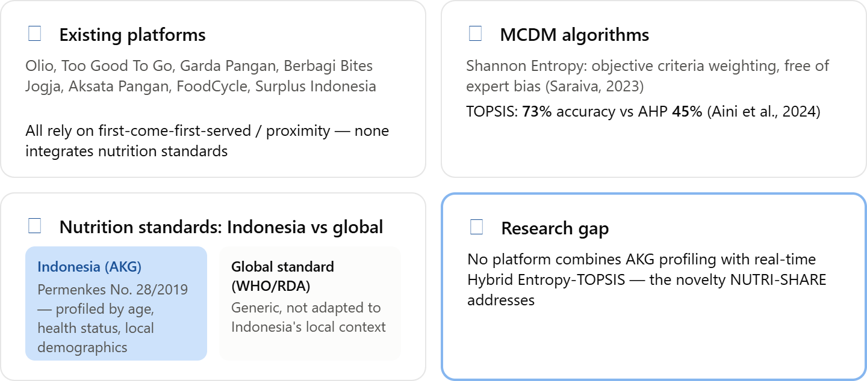
Research Survey:

Slide 6
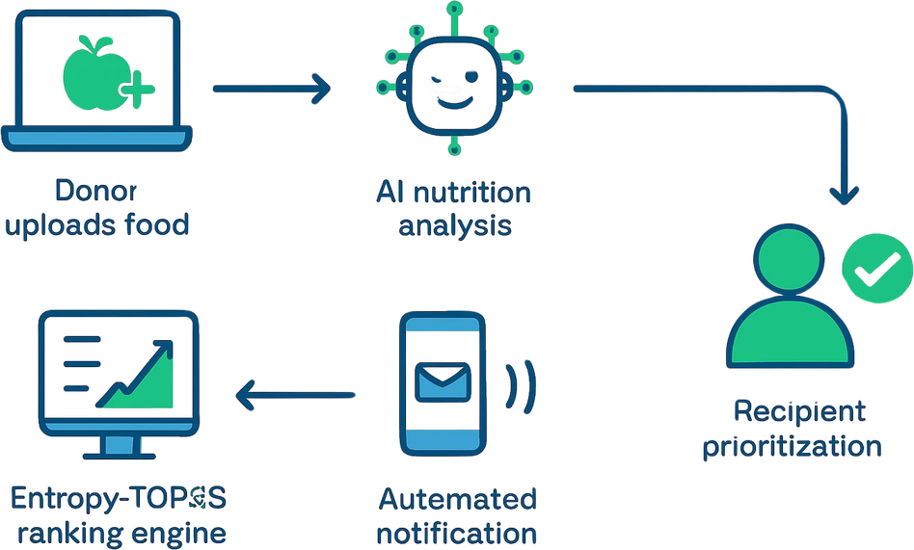
Proposed Solution:
NUTRI-SHARE: DSS based on nutrition, not just speed or location.
NUTRI-SHARE a web-based Decision Support System that prioritizes nutritional impact, not first come first served.
Hybrid Entropy-TOPSIS Shannon Entropy considers 5 criteria (nutritional density, health urgency, food suitability, location distance, aid history); TOPSIS ranks recipients objectively & transparently.
AKG Integration each recipient entity is profiled according to Minister of Health Regulation No. 28/2019 to measure nutritional gap.
Distribution mechanism priority score is calculated automatically when donations come in, notifications are sent to the top ranking recipients, with the system fallback to the next recipient if not responded to.

Slide 7
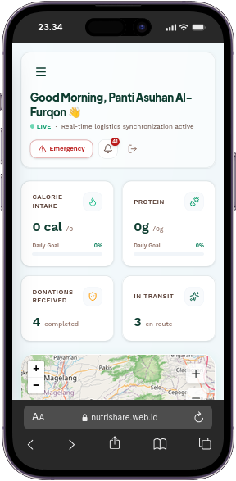
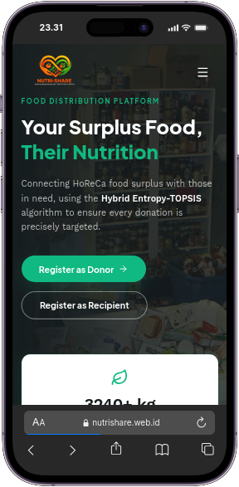
Prototype (if applicable):
  • Core Hybrid Entropy-TOPSIS Engine — Real-time multi-criteria DSS combining Shannon Entropy for objective dynamic weighting (wj) from data dispersion and TOPSIS for Euclidean relative closeness ranking (Vi) to the ideal solution (A+).
• Dynamic 5-Criteria Matrix & AKG Profiling — Automates decision matrix X_mxn matching surplus macros against AKG deficits (C1: Nutritional Gap per Permenkes 28/2019), C2: Vulnerability Urgency, C3: Dietary Fit, C4: Haversine Distance, and C5: Aid History Penalty.
• Full-Stack Web App with Automated Fallback — FastAPI & React 19 SPA featuring live DSS computation audits, exclusive priority claim windows for Rank #1 with automated fallback cascading, and interactive Leaflet GIS tracking.

Slide 8

Advantages & Disadvantages:
ADVANTAGES:
+ Nutrition-Driven Fair Allocation: Eliminates unfair First-Come-First-Served distribution using an objective multi-criteria DSS (Entropy-TOPSIS + AKG nutritional standards).
+ Measurable Socio-Economic & SDG Impact: Directly targets Hidden Hunger and Food Waste reduction (SDG 2, 3, and 12) with verifiable metric reporting.
+ End-to-End Traceability & Engagement: Real-time interactive routing via Leaflet maps, automated priority fallback, and donor gamification badges to encourage consistent participation.
DISADVANTAGES & MITIGATION:
- HoReCa Operational Dependency: Relies on donor discipline to accurately input surplus food condition, preparation time, and nutritional parameters.
- Cold-Chain & Time-Window Constraints: Perishable high-protein cooked food requires rapid courier dispatch within tight safe-consumption windows (2-4 hours).

Slide 9
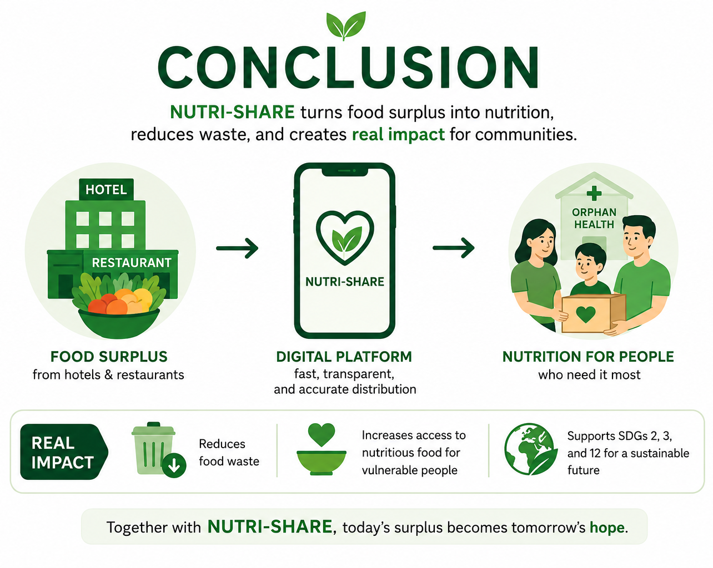
CONCLUSION
NUTRI-SHARE transforms surplus food into a measurable social impact through an integrated, data-driven distribution system.
Solves two problems at once: reduces food waste while improving access to nutritious food for vulnerable communities.
Creates measurable impact: more surplus food can be redistributed, food waste is reduced, and more people gain access to nutritious meals.
Strengthens collaboration: connects hotels, restaurants, government, NGOs, and communities in one integrated distribution ecosystem.
Supports sustainable development: contributes directly to SDG 2 (Zero Hunger), SDG 3 (Good Health and Well-being), and SDG 12 (Responsible Consumption and Production).
Real impact: NUTRI-SHARE has the potential to create a sustainable food distribution model that is scalable, transparent, and beneficial for both people and the environment.
In conclusion, NUTRI-SHARE is not only a food redistribution platform, but a sustainable solution that turns food surplus into nutrition, reduces waste, and creates a measurable positive impact on society.

Slide 10
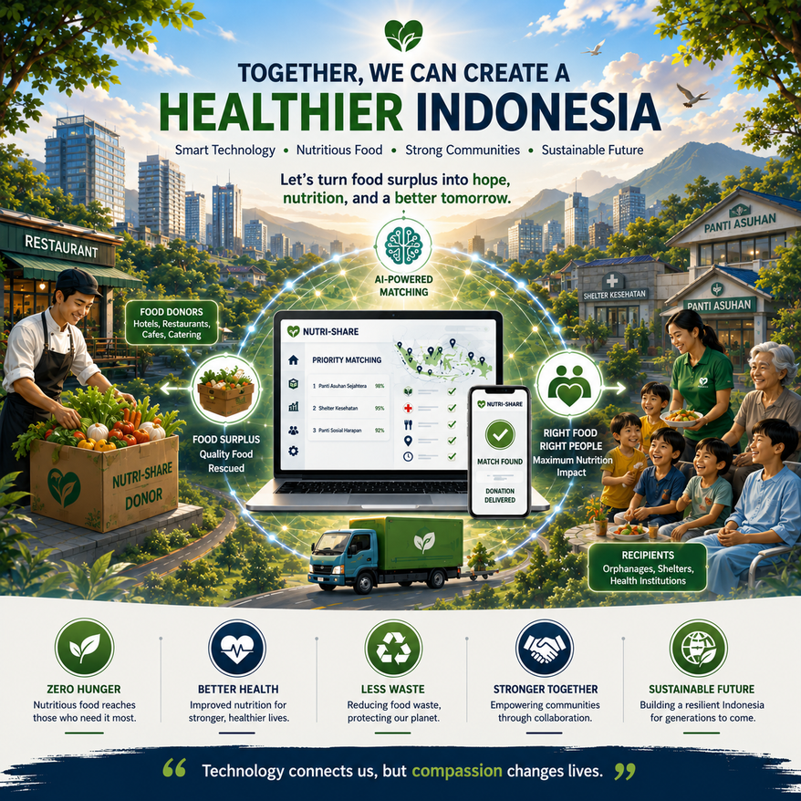
Conclusion:
NUTRI-SHARE: from mere food rescue to equitable distribution of nutrition.
New paradigm— combines AKG standards and Hybrid Entropy-TOPSIS logic into a real-time digital platform, ensuring the highest nutritional value food surplus reaches the most vulnerable recipients.
Integrated solutions— addressing the food waste crisis (23-48 million tonnes/year) andhidden hungerat the same time, it is technically mature, measurable, and ready to be implemented.
In line with SDGs - support SDG 2 (Zero Hunger), SDG 3(Health & Wellness), andSDG 12(Responsible Consumption & Production).
Scale-up potential— through the PKM-PI/PKM-PM scheme, government & NGO partnerships, has the potential to become a national model for data and nutrition-based food distribution.

Slide 11
References:
  Aini, D.N. et al. (2024). Comparison of TOPSIS and SMARTER Methods in Selecting Delivery Services. IJATIS, 1(1), 30–40. doi: 10.57152/ijatis.v1i1.1139.
  BAPPENAS. (2021). Food Loss and Waste di Indonesia. Jakarta: BAPPENAS.
  Cao, X., Wei, C. and Xie, D. (2021). Evaluation of scale management suitability based on the Entropy-TOPSIS method. Land, 10(4). doi: 10.3390/land10040416.
  Chaudhary, R., Kinkar, B. and Arya, B. (2026). Zero Waste Chain: A Smart Platform for Bridging Food Waste and Food Need. American Journal of Education and Evaluation Studies, 3(01).
  Eitiveni, I. et al. (2025). Analysis of factors influencing use intention of food rescue applications: A case study of Surplus Indonesia. Sustainable Futures, 10. doi: 10.1016/j.sftr.2025.100948.
  Lam, W.S., Lam, W.H. and Lee, P.F. (2026). Evaluation of Financial Risk Management Using Integrated Entropy-Weight TOPSIS Model. Journal of Risk and Financial Management, 19(2). doi: 10.3390/jrfm19020108.
  Ranjbari, M. et al. (2024). Digitally enabled food sharing platforms towards effective waste management in a circular economy. Technovation, 130. doi: 10.1016/j.technovation.2023.102939.
  Tzitiridou-Chatzopoulou, M. et al. (2024). Evaluating Malnutrition Practices Using Entropy-Weight and TOPSIS Method. Children, 11(8). doi: 10.3390/children11080903.
  Weffort, V.R.S. and Lamounier, J.A. (2024). Hidden hunger a narrative review. Jornal de Pediatria, 100, S10–S17. doi: 10.1016/j.jped.2023.08.009.
  Peraturan Menteri Kesehatan No. 28 Tahun 2019 tentang Angka Kecukupan Gizi yang Dianjurkan untuk Masyarakat Indonesia.

Slide 12

Thank You

